Slide 1
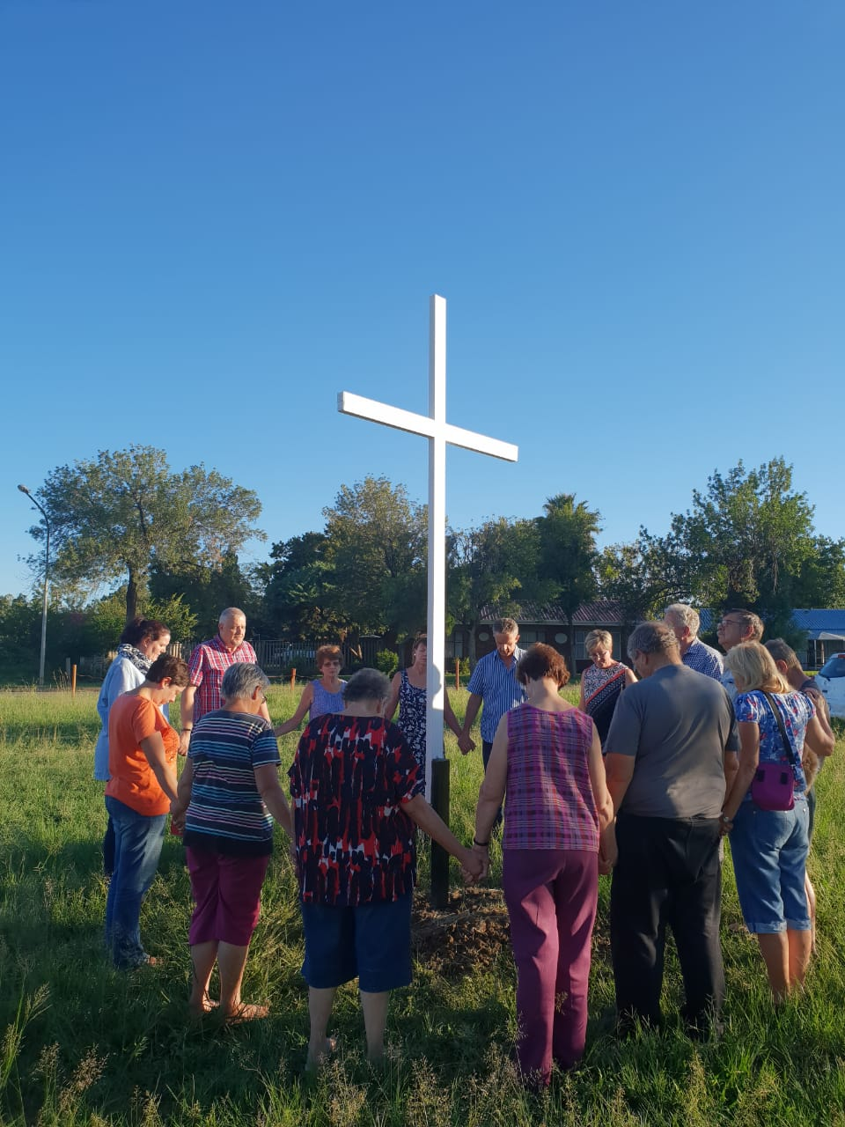
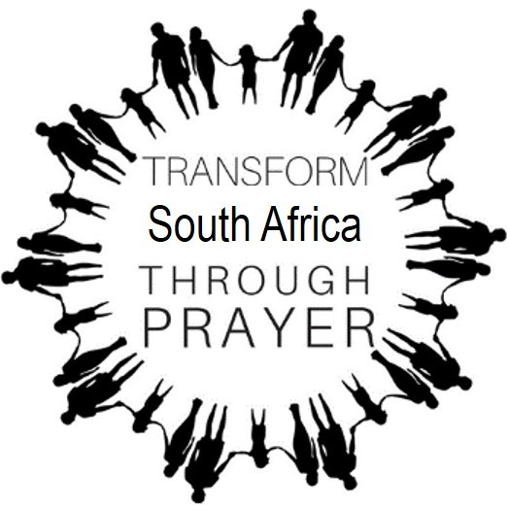
JOIN SA PRAYER CIRCLES!

Slide 2
OUR VISION
Transform
South Africa
through prayer

Slide 3
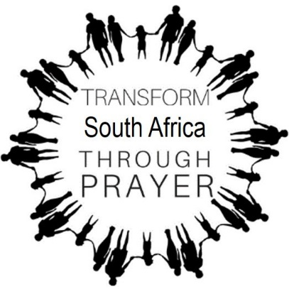
OUR MISSION
To establish a Prayer Circle in every suburb of the city that come together once a week to pray for specific problems in each suburb as well as for the city at large.

Slide 4
Prayer Circles are established in
parks because parks serve as neutral ground:
it belongs to everyone and unifies people from different groups
and denominations.

Slide 5
We plant a CROSS in each park where we convene.
Each cross is inscribed with the words
‘AS IN HEAVEN, SO IN THIS CITY’,
proclaiming the area for the Lord.

Slide 6
Why we do this
For our struggle is not against flesh and blood, but against the rulers, against the authorities, against the powers of this world’s darkness, and against the spiritual forces of evil in the heavenly realms (Ephesians 6:12)

Slide 7
WE PRAY EVERY MONDAY
18H00
FOR 15 MINUTES
AT A PRAYER CIRCLE NEAR YOU
To join contact:
……………………….

